Slide 1
Neural Networks
2021 AlgoExpert
Yang Xi’s Reading Notes

Slide 2
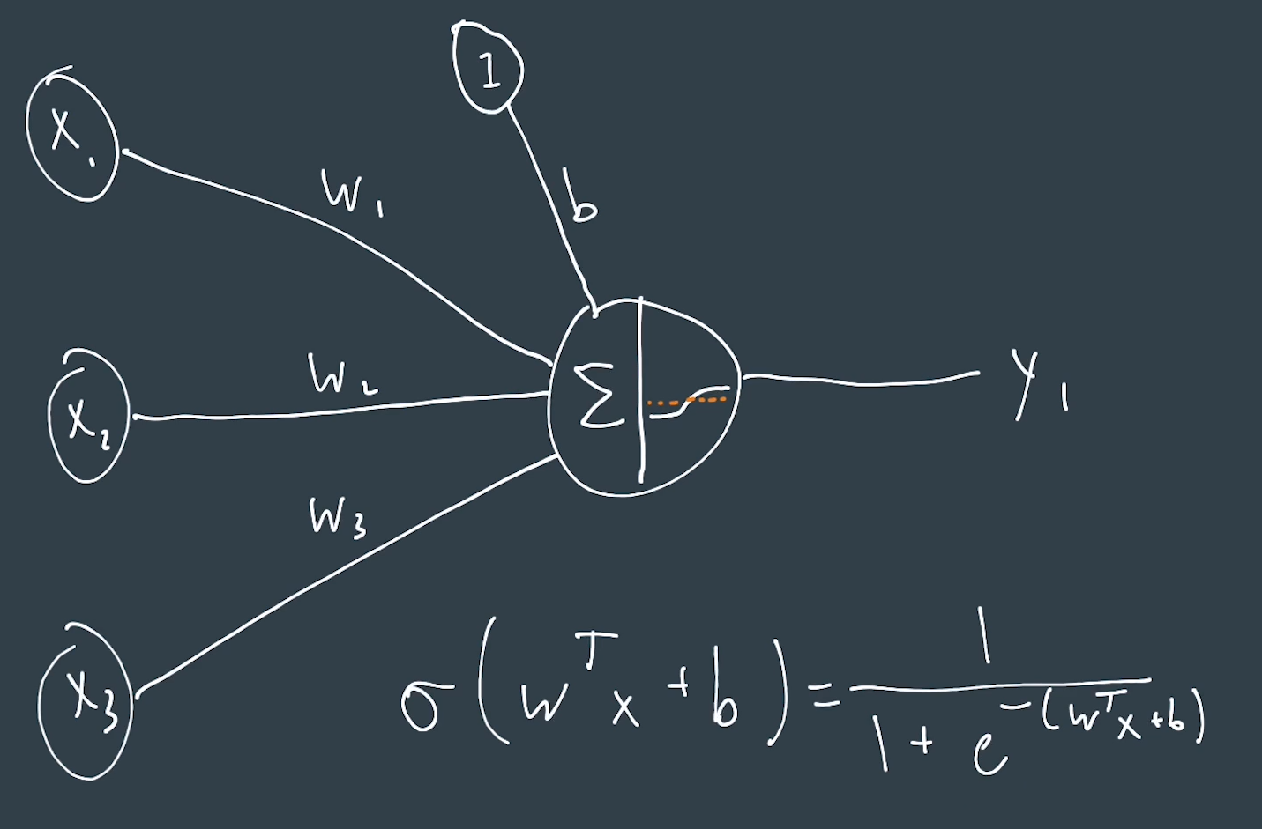
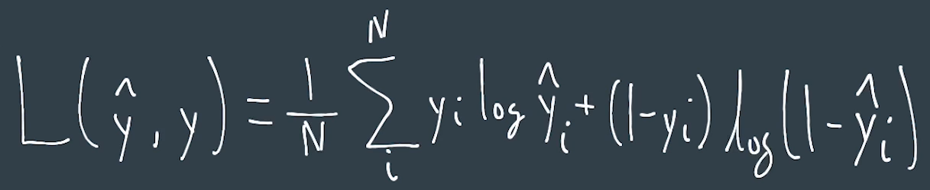
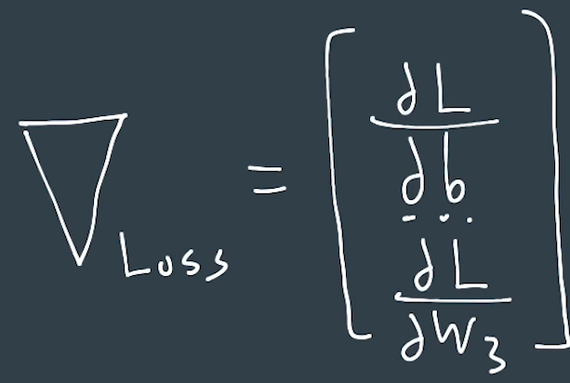
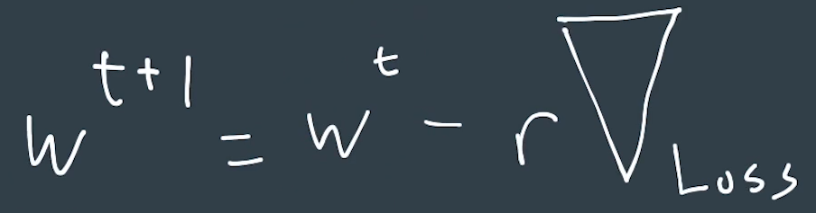
Neuron (perceptron)
A neuron is a graphical representation of the smallest part of a NN.
It is also referred as nodes or units.
Below is a neuron with sigmoid activation function (logistic regression).
Loss Function:
Gradient: A vector of partial derivatives
Update Weights:

Slide 3
Notes
Deeper of Wider?
Compared to wider network, deeper network generally needs fewer overall parameters.
Fully Connected
Every single input connects to every single neuron in the next layer

Slide 4
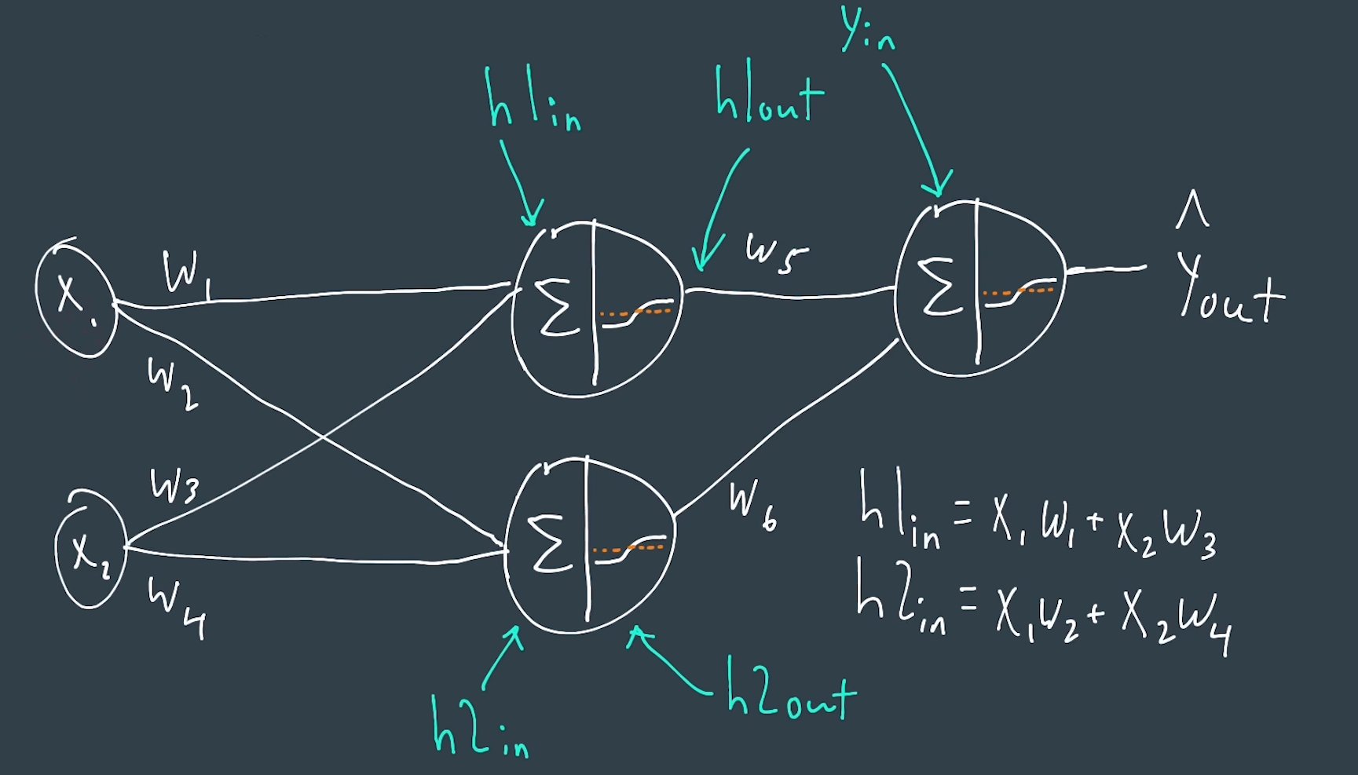
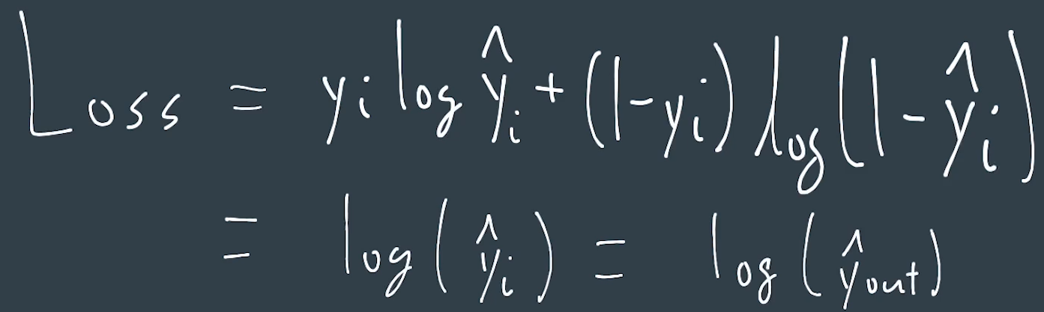
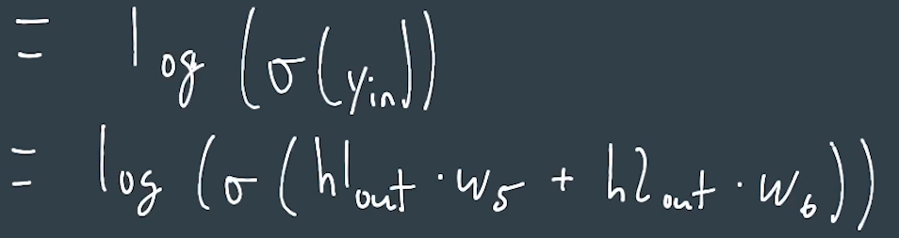
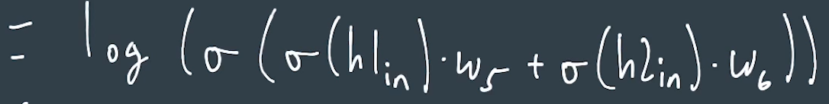
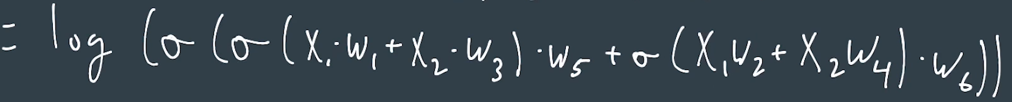
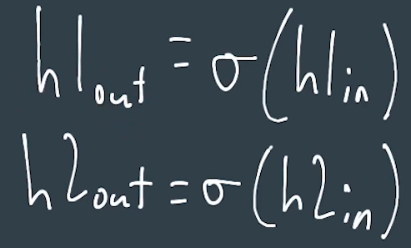
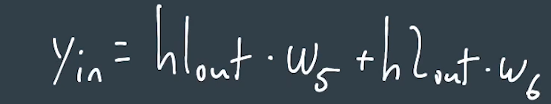
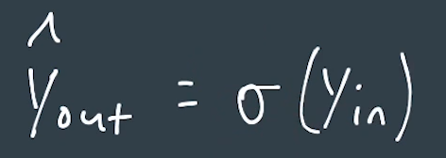
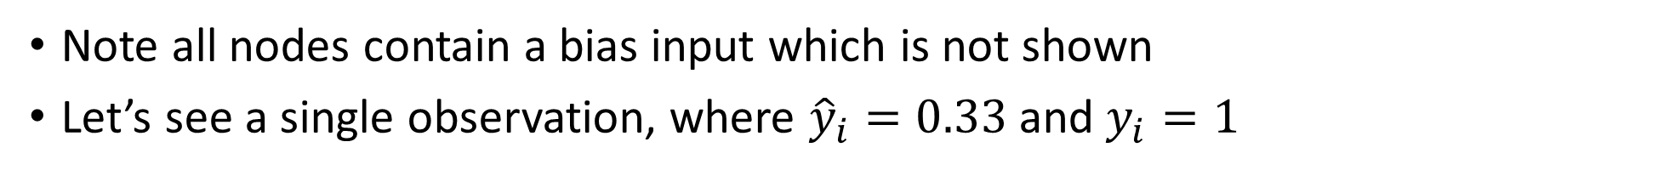
NN – An example
Note all nodes contain a bias input which is not shown
Let’s see a single observation, where ${\hat{y}}_{i}=0.33$ and $y_{i}=1$

Slide 5
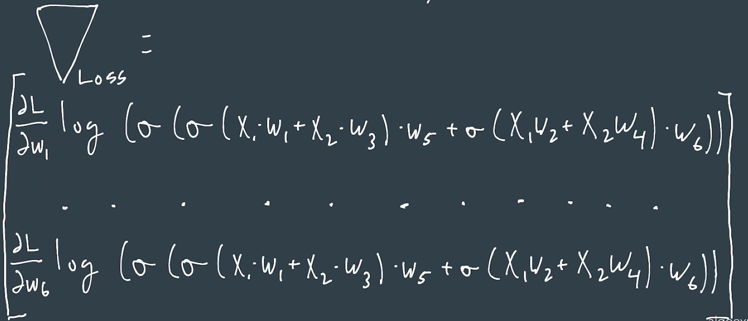
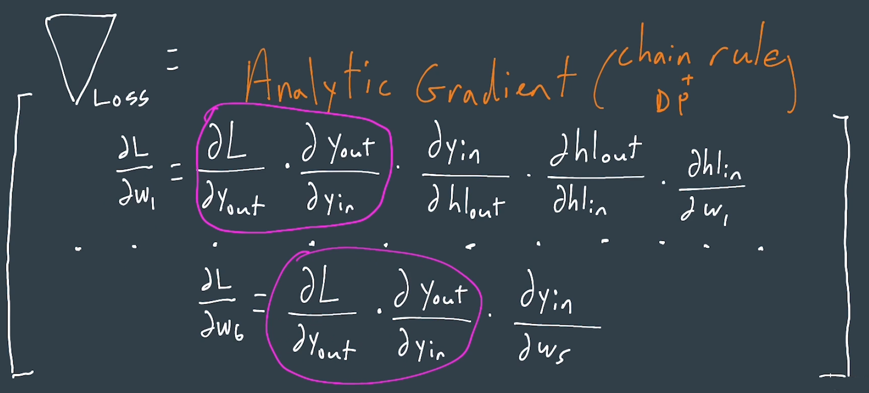
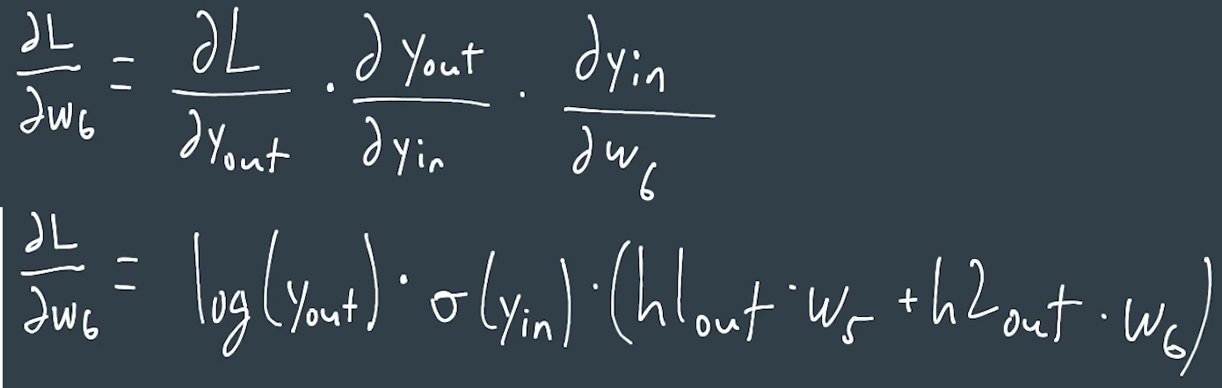
NN – An example – How to get the Gradient (of Loss)?
Numeric Gradient
Take a small delta of each inputs and bias and see how much the loss changed
Extremely inefficient
Can be used as a gradient checking
Analytical Gradient
Use math to calculate the derivative
Chain Rule + Dynamic Programming ➔ Back Propagation
Training
Forward Pass: get prediction and loss
Back Propagation: update weights

Slide 6
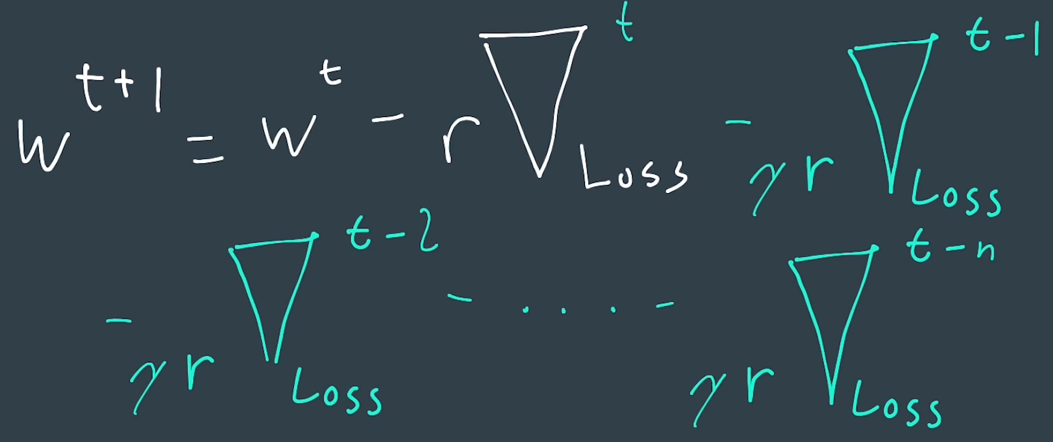
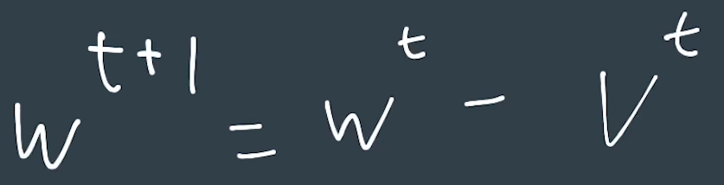
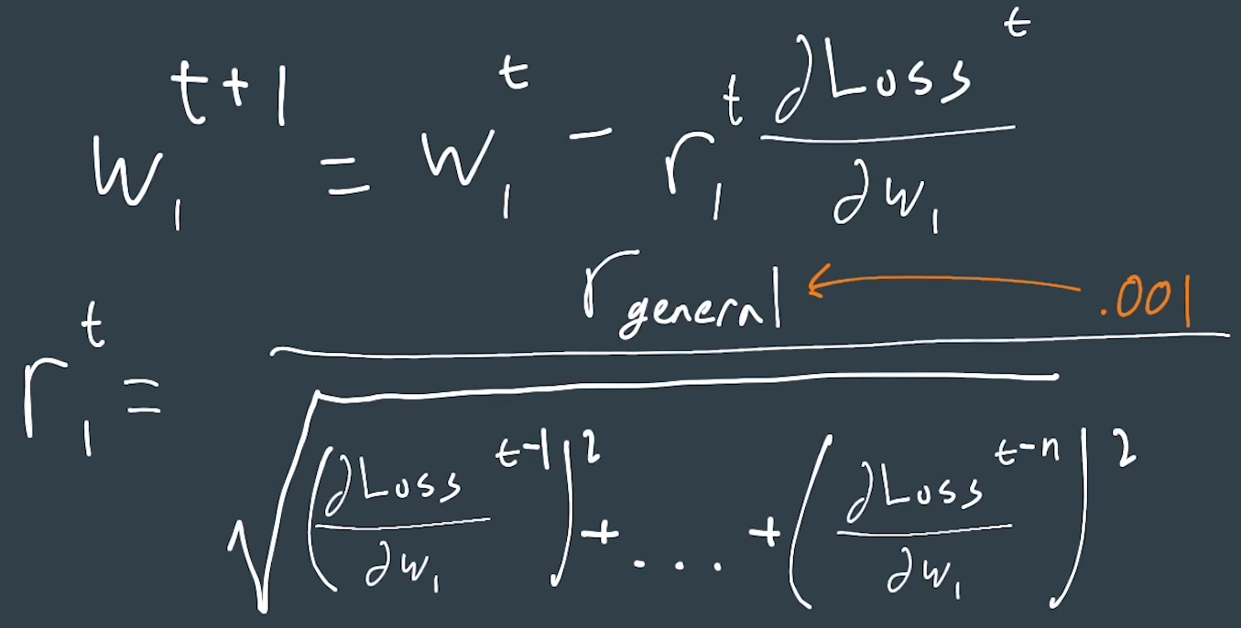
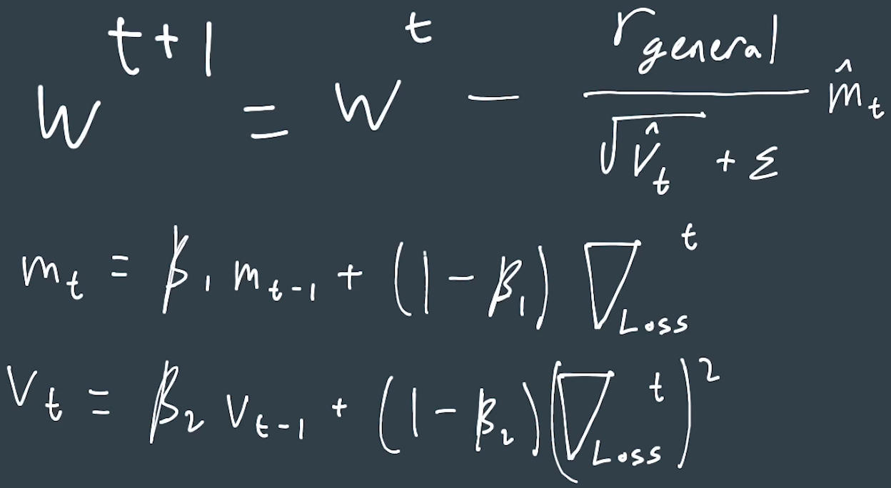
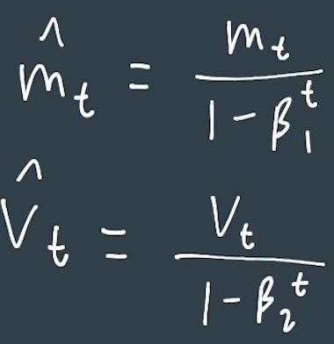
Local Optima, Momentum, Adagrad and Adam
How to increase the chances to not get stuck in the local optima?
Stochastic Gradient Descent
Take a random observation and update weight with just that observation
Problem: slow to converge
Momentum
Also use previous gradients to update weights
Problem: built too much momentum and jump pass the global optima
Adagrad
Learning rate per parameter (weight)
Why different learning rate per parameter?
If Wi has been updated a lot and gradient is high, this algo with lower the learning rate
If Wi has been updated little and gradient is low, this algo with increase the learning rate
Very helpful in sparse features
Adam = Momentum + Adagrad

Slide 7
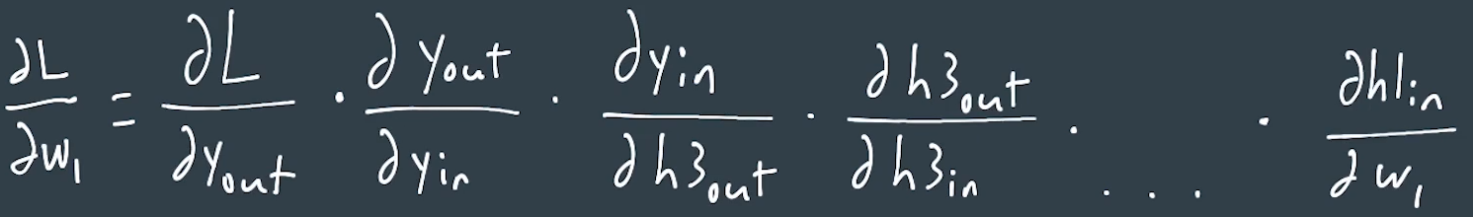
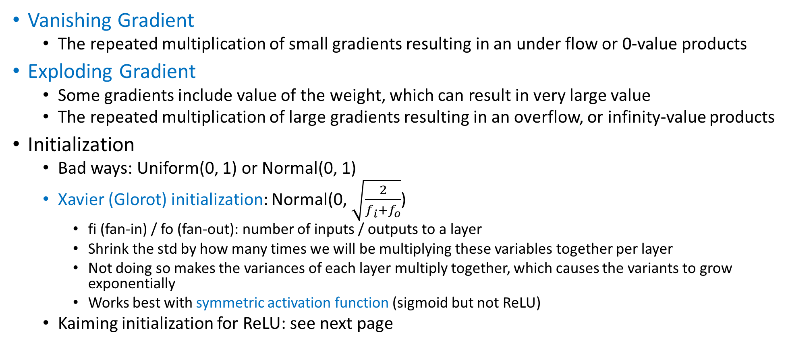
Vanishing / Exploding Gradient, Initialization
Vanishing Gradient
The repeated multiplication of small gradients resulting in an under flow or 0-value products
Exploding Gradient
Some gradients include value of the weight, which can result in very large value
The repeated multiplication of large gradients resulting in an overflow, or infinity-value products
Initialization
Bad ways: Uniform(0, 1) or Normal(0, 1)
Xavier (Glorot) initialization: Normal(0, $\sqrt{\frac{2}{f_{i}+f_{o}}}$)
fi (fan-in) / fo (fan-out): number of inputs / outputs to a layer
Shrink the std by how many times we will be multiplying these variables together per layer
Not doing so makes the variances of each layer multiply together, which causes the variants to grow exponentially
Works best with symmetric activation function (sigmoid but not ReLU)
Kaiming initialization for ReLU: see next page

Slide 8
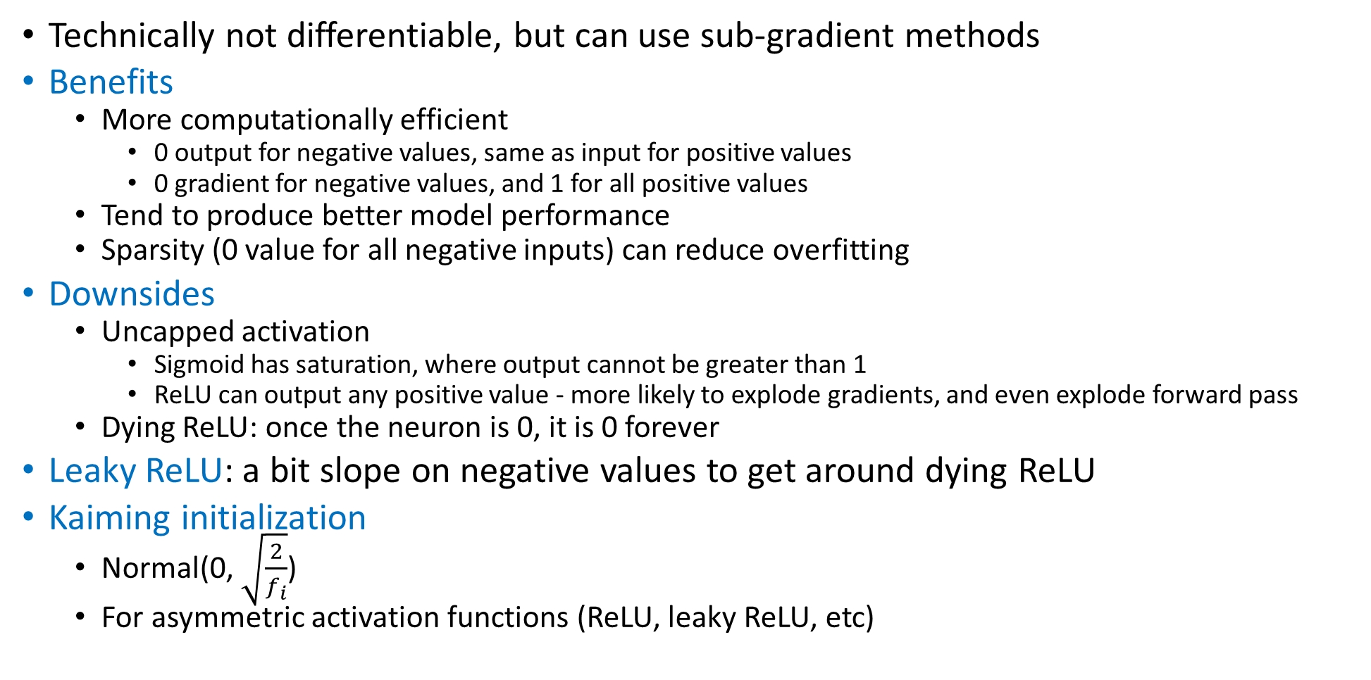
Rectified Linear Unit (ReLU)
Technically not differentiable, but can use sub-gradient methods
Benefits
More computationally efficient
0 output for negative values, same as input for positive values
0 gradient for negative values, and 1 for all positive values
Tend to produce better model performance
Sparsity (0 value for all negative inputs) can reduce overfitting
Downsides
Uncapped activation
Sigmoid has saturation, where output cannot be greater than 1
ReLU can output any positive value - more likely to explode gradients, and even explode forward pass
Dying ReLU: once the neuron is 0, it is 0 forever
Leaky ReLU: a bit slope on negative values to get around dying ReLU
Kaiming initialization
Normal(0, $\sqrt{\frac{2}{f_{i}}}$)
For asymmetric activation functions (ReLU, leaky ReLU, etc)

Slide 9
Summary – Initialization and Activation Function
Initialization
Xavier: for symmetric activation function
Kaiming: for asymmetric activation function
Feature Scaling: scale your features can improve the converging rate
Activation Functions
Sigmoid: 0 to 1
ReLU, leaky ReLU
Hyperbolic Tangent (Tanh): -1 to 1
Output nodes:
Sigmoid: binary classification
Softmax: multi-class classification
Linear: regression

Slide 10

Summary – Loss Functions
Loss Functions
Regression
Mean Squared Error (L2 Loss): $L\left(y,\hat{y}\right)=\frac{\sum_{N}{{\left(y_{i}−{\hat{y}}_{i}\right)}^{2}}}{N}$, for mini-batch size N
Mean Absolute Error (L1 Loss): $L\left(y,\hat{y}\right)=\frac{\sum_{N}{|y_{i}−{\hat{y}}_{i}|}}{N}$, for mini-batch size N
Classification
Cross-Entropy (Log Loss): $L\left(y, \hat{y}\right)=−[y\log{\hat{y}}+\left(1−y\right)\log\left(1−\hat{y}\right)]$
Multi-class: $L\left(y,\hat{y}\right)=−\sum_{K}{y_{i}\log{{\hat{y}}_{i}}}$

Slide 11
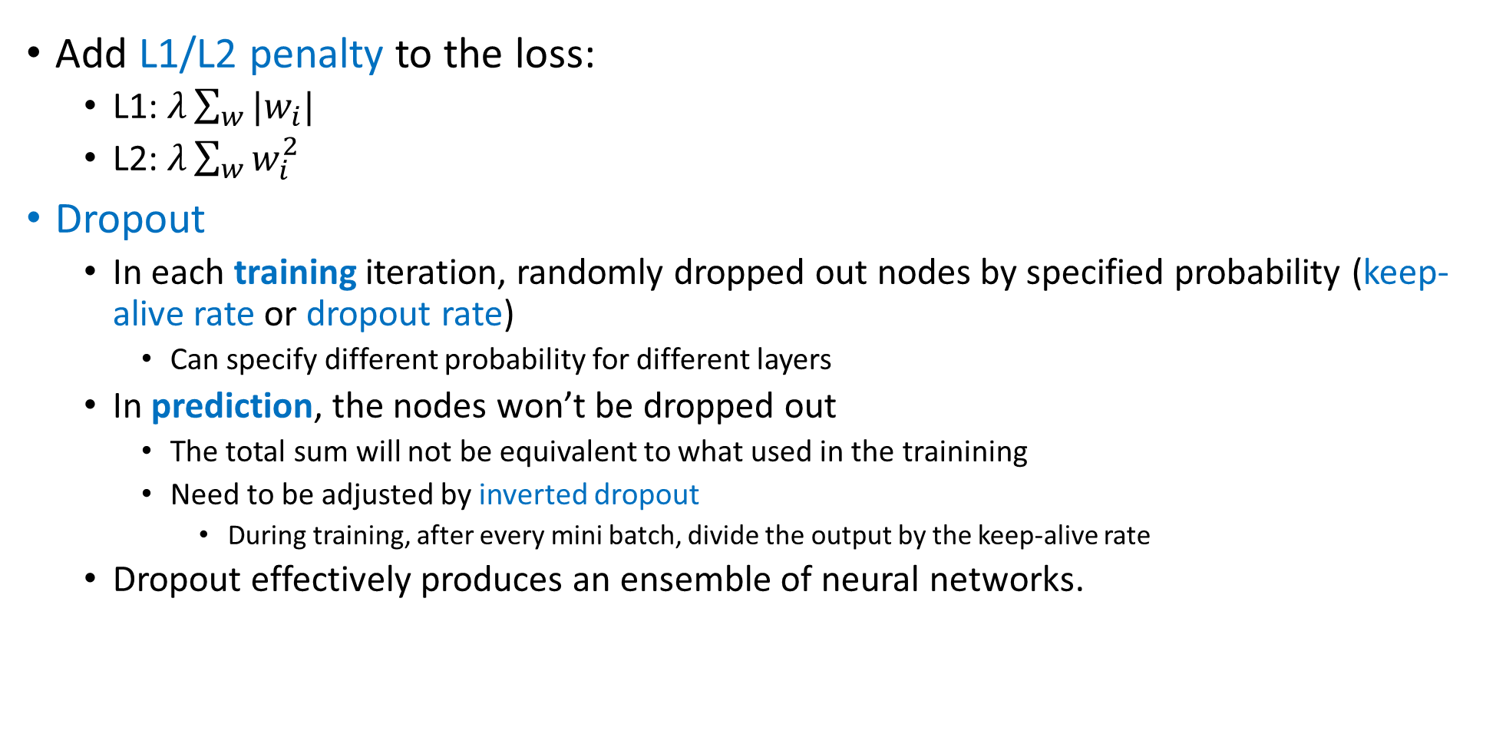
Regularization
Add L1/L2 penalty to the loss:
L1: $λ\sum_{w}{|w_{i}|}$
L2: $λ\sum_{w}{w_{i}^{2}}$
Dropout
In each training iteration, randomly dropped out nodes by specified probability (keep-alive rate or dropout rate)
Can specify different probability for different layers
In prediction, the nodes won’t be dropped out
The total sum will not be equivalent to what used in the trainining
Need to be adjusted by inverted dropout
During training, after every mini batch, divide the output by the keep-alive rate
Dropout effectively produces an ensemble of neural networks.

Slide 12
Architecture
If your data is linear separatable, you don’t need any hidden layer
Start with one hidden layer
Number of neurons = (input + output) / 2
Start with more layers and units than you need
Pruning Neurons
Check which weights are near zero after training
Then prune the surrounding neurons
If equivalent performance can be obtained, those neurons can be pruned

